Slide 1

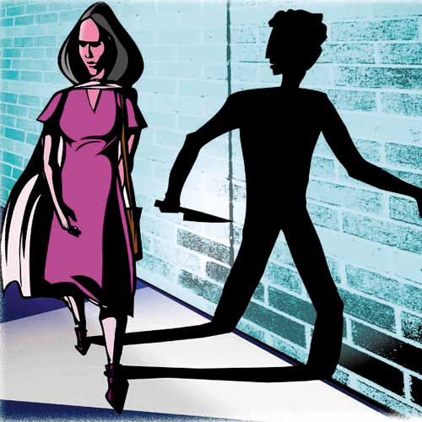

RAKSHA
A Security Application

Slide 2



WHY ?

Slide 3

Security Purpose
There are a million ways to defend yourself. There are a million people telling you how to do it. I’m not trying to be either of those. What I do want to do is help you become aware of some really basic self awareness/situational awareness things you can do to help you increase your safety when you’re out.
To provide safety measures to those who are in trouble.
To spread awareness among people about this application.
To pass information to the cobs about the persons who faces trouble.
To alert every one that he/she is in trouble.
By this we can handle the trouble situations in an easy way and provide them safety and security.

Slide 4


HOW ????

Slide 5


ANDROID STUDIO
This application is developed with the help of android studio which is the official Integrated Development Environment (IDE) for Google’s android application system.
Android is developed by Andy Rubin.

Slide 6

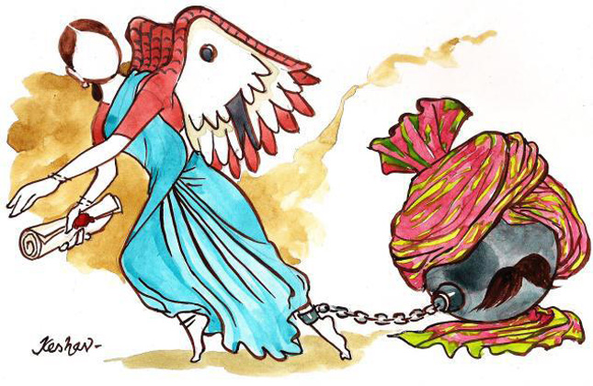

What???

Slide 7


RAKSHA APPLICATION
Application logo

Slide 8

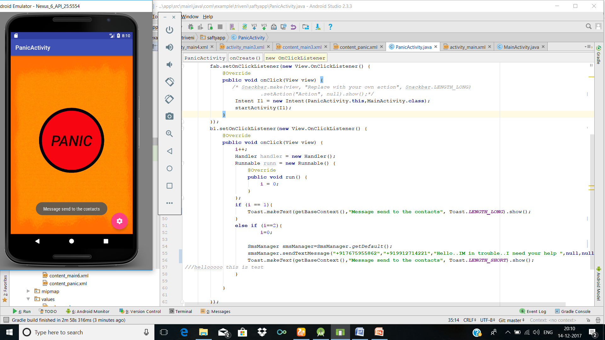
First screen
Here is the panic button
By clicking it an alert message
Will be forwarded to the
Selected contacts.
-->After clicking the button
there will a pop up message
displayed for the conformation

Slide 9

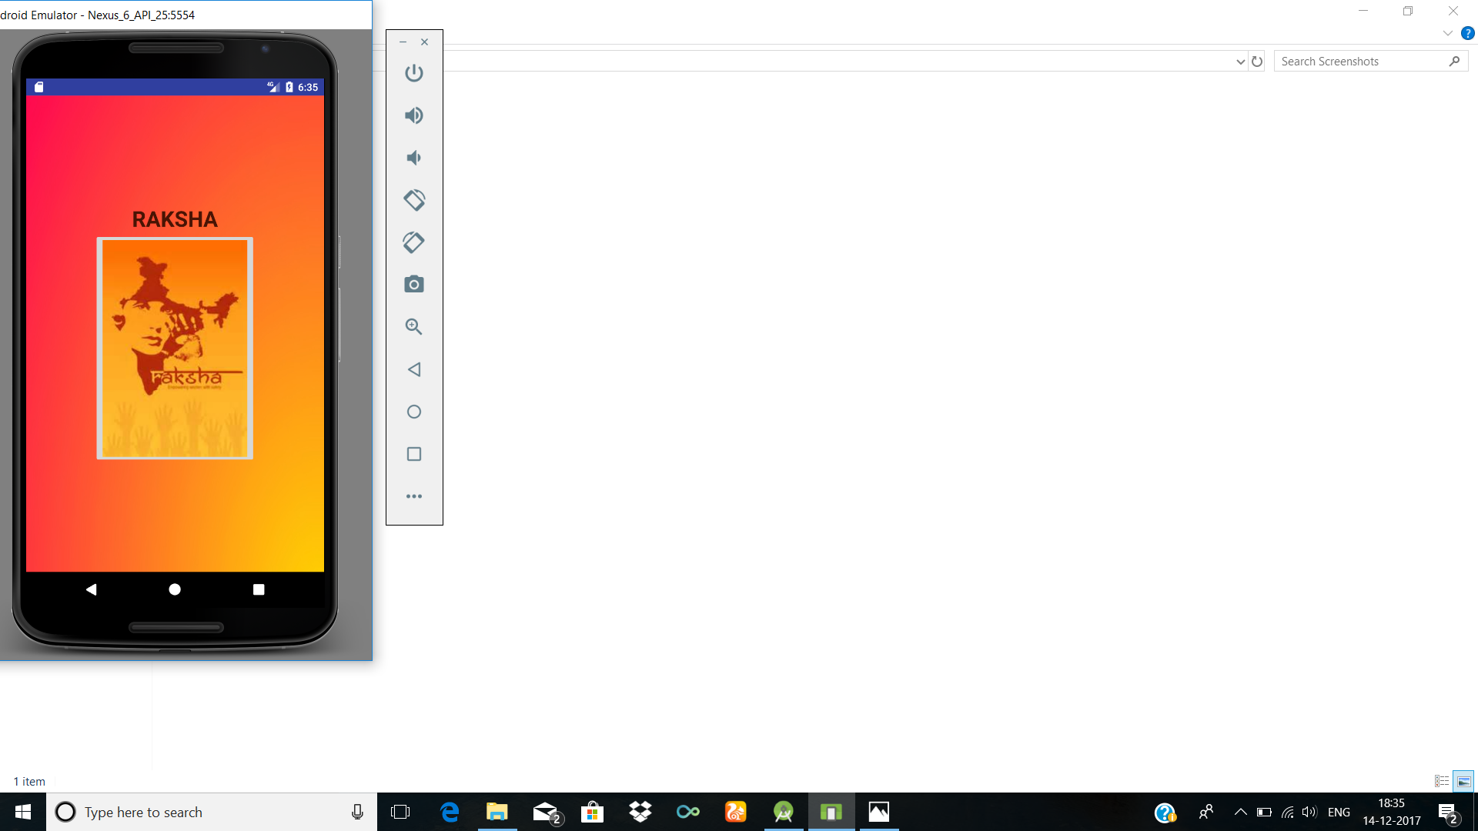
Home Screen
By clicking settings button in the first screen Title screen
will open, where an image Button is seen.

Slide 10

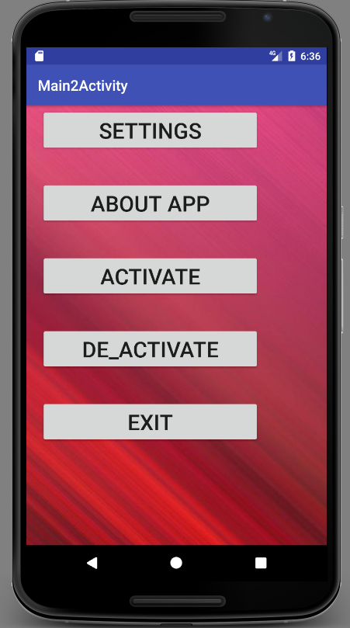
By clicking image button in
the title screen ,menu screen
will open and there are few
Buttons as follows.
Menu screen
→Settings
→About App
On clicking settings button
in the menu screen, another
screen will open...
On clicking about app in
the menu screen, another
will be opened where user
can get the complete
information about
the application.
→Activate
To Activate Panic Activity which will help the user in sending messages.
→Deactivate
→Exit
To deactivate all the features.
To exit from application.

Slide 11

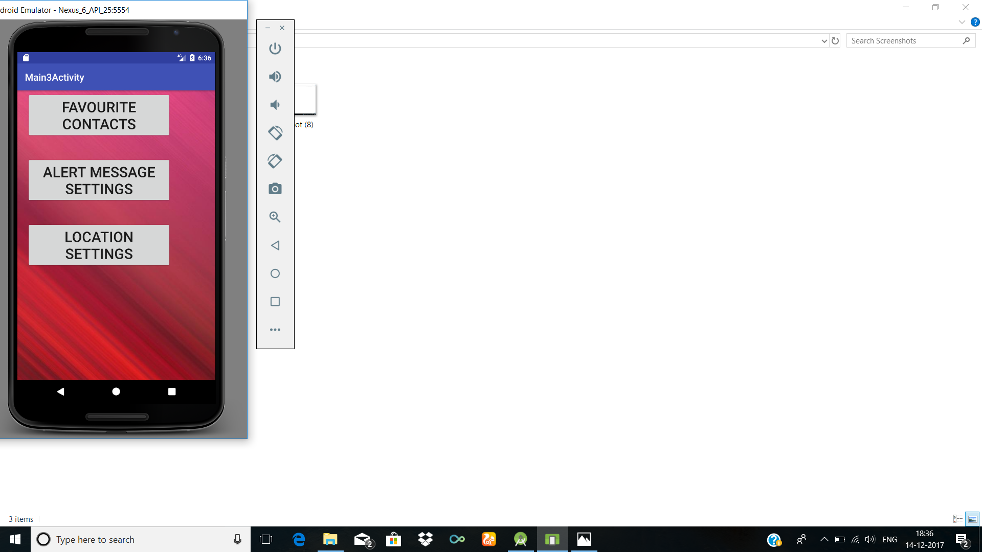
Settings
→Favourite contacts
On clicking the Favourite contacts user will be able to set his own selected contact list in it.
→Alert message settings
On clicking alert message
settings the user will be able
to give his own alert message
in it.
→Location settings
On clicking the location
Settings ,the user will trace
Location of person who is in trouble.

Slide 12

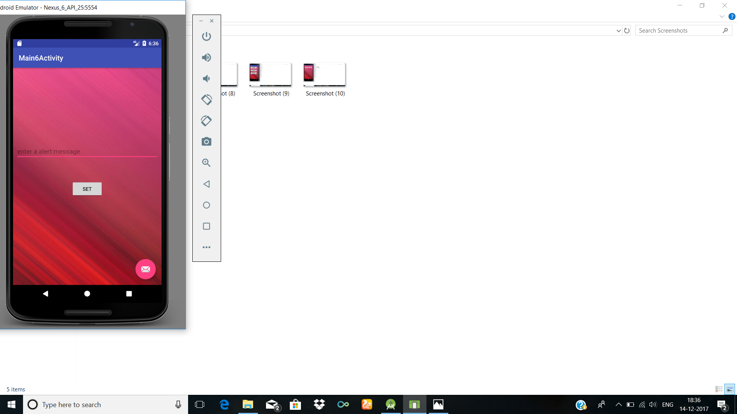
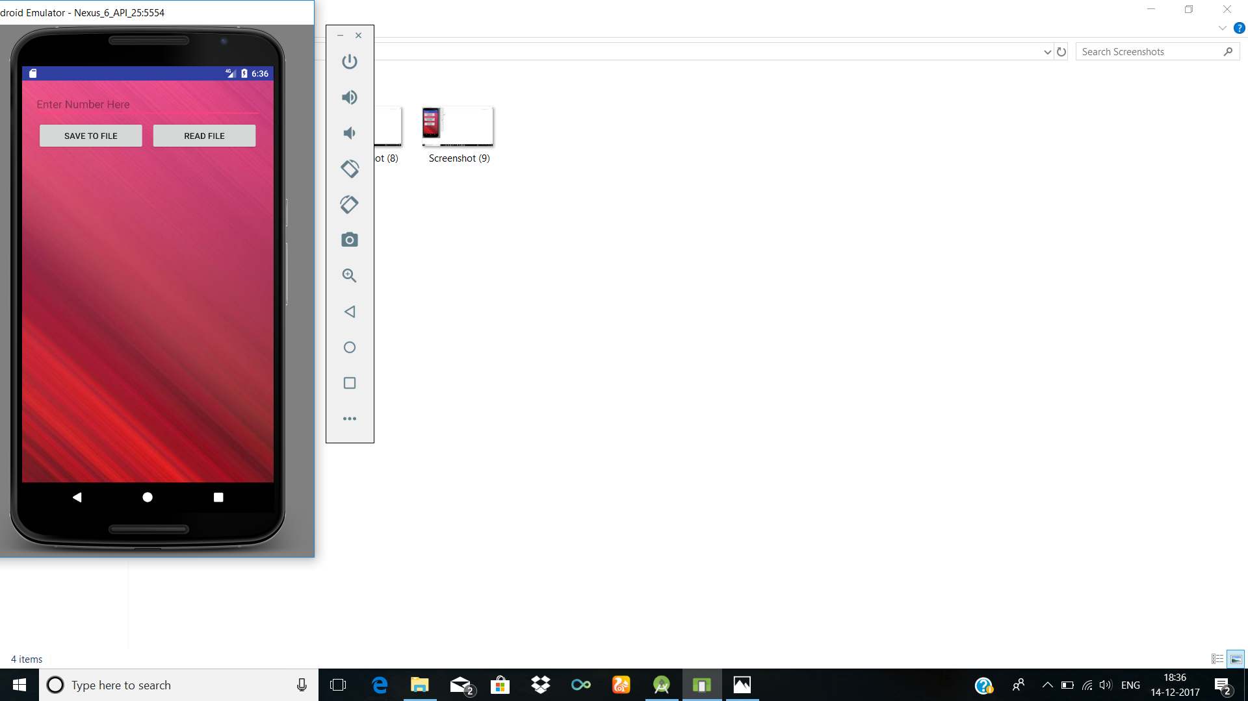
On clicking the Favourite
contacts
On clicking alert message
Settings.

Slide 13
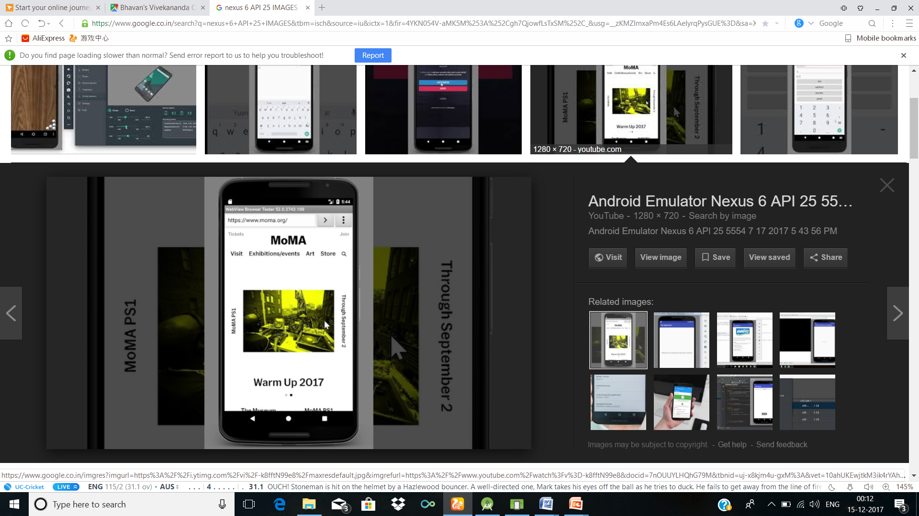
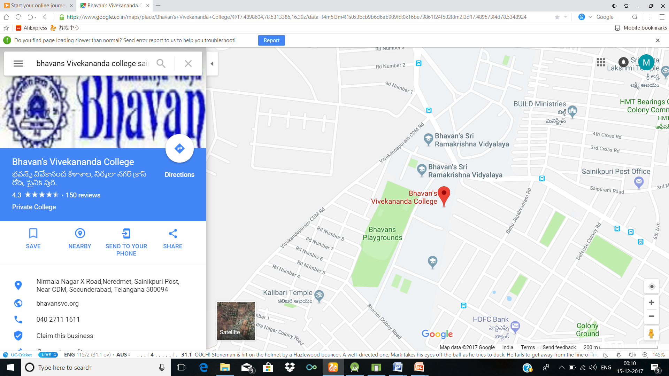
On click location settings
On clicking the location
settings the user will be
tracing his exact location.

Slide 14
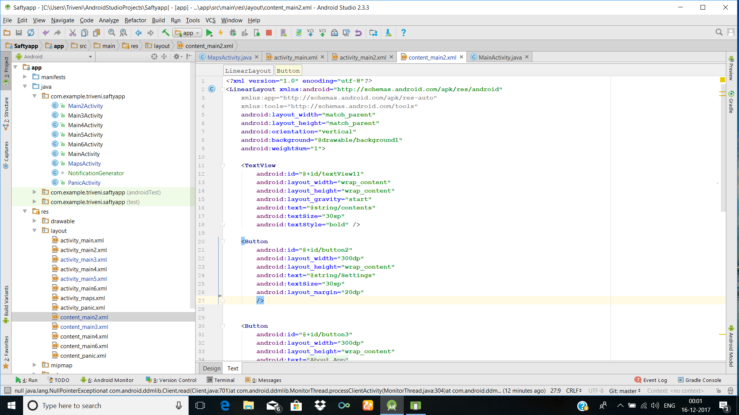
Android studio files(.xml)

Slide 15
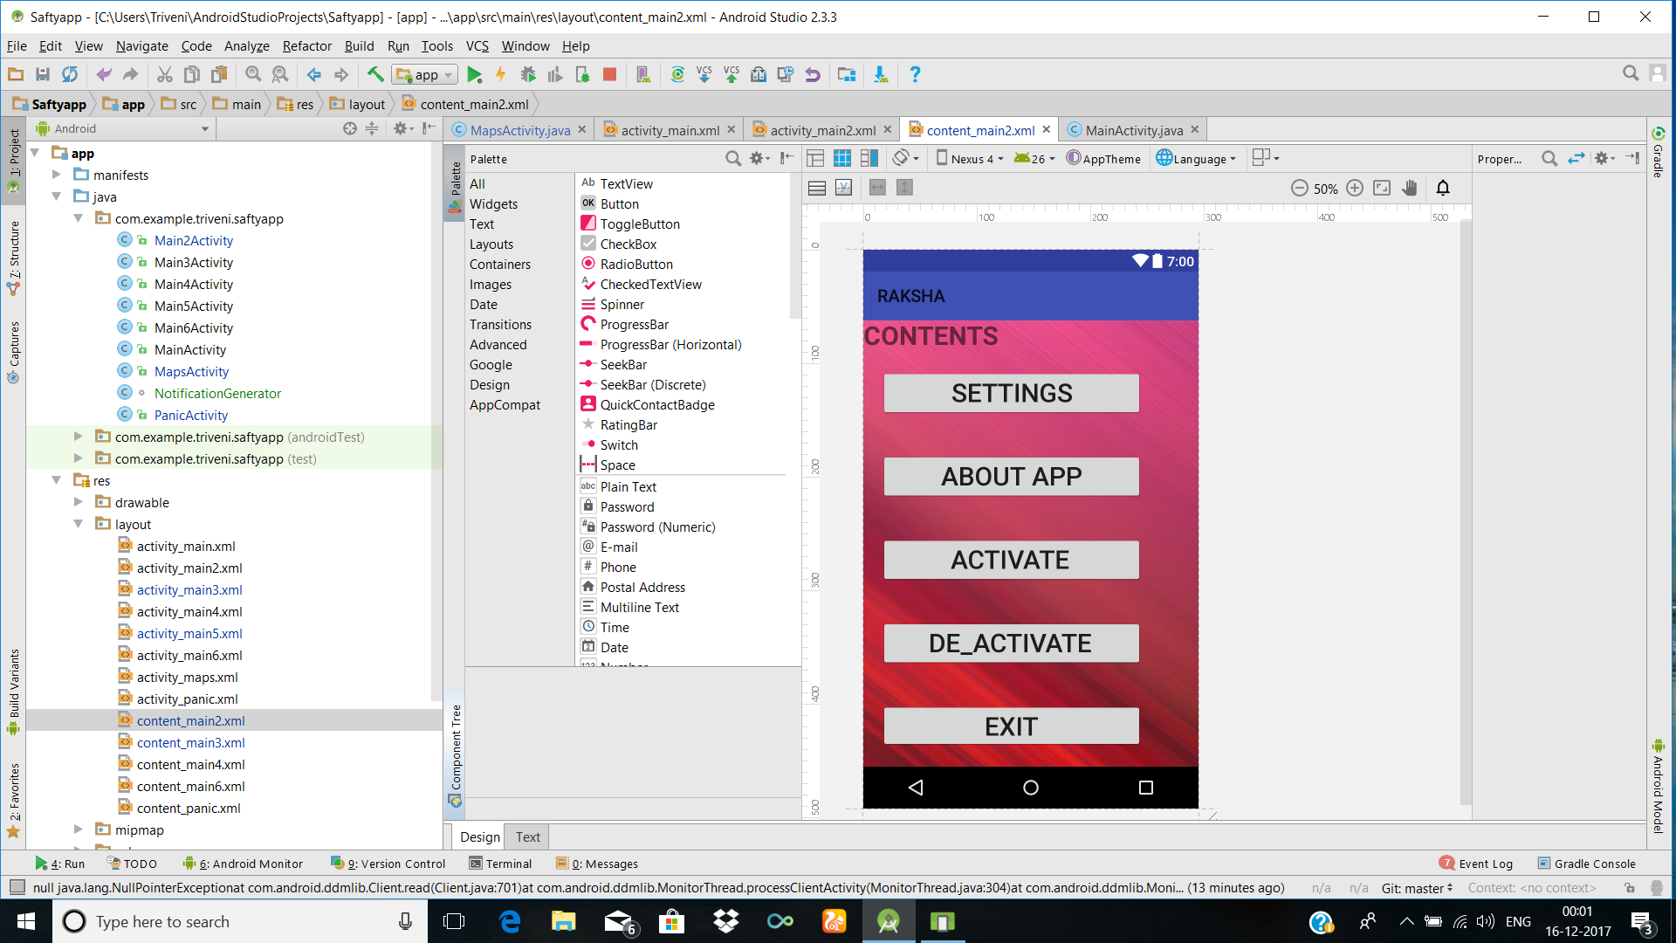
(.xml-Design part)

Slide 16
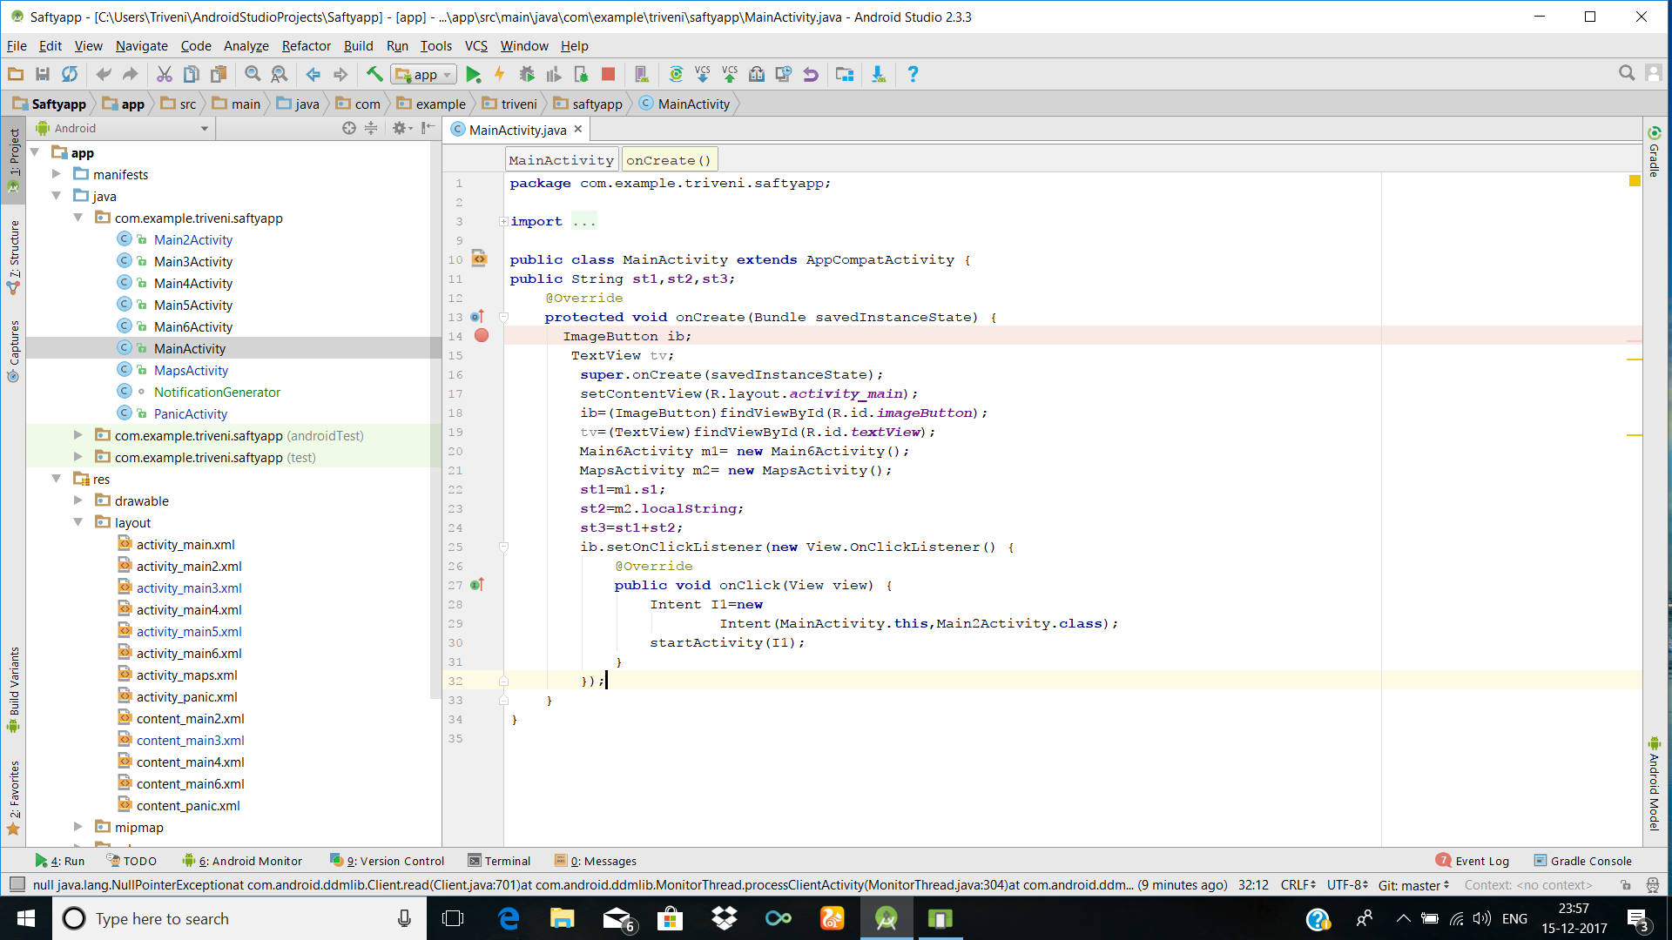
Basic Java coding

Slide 17
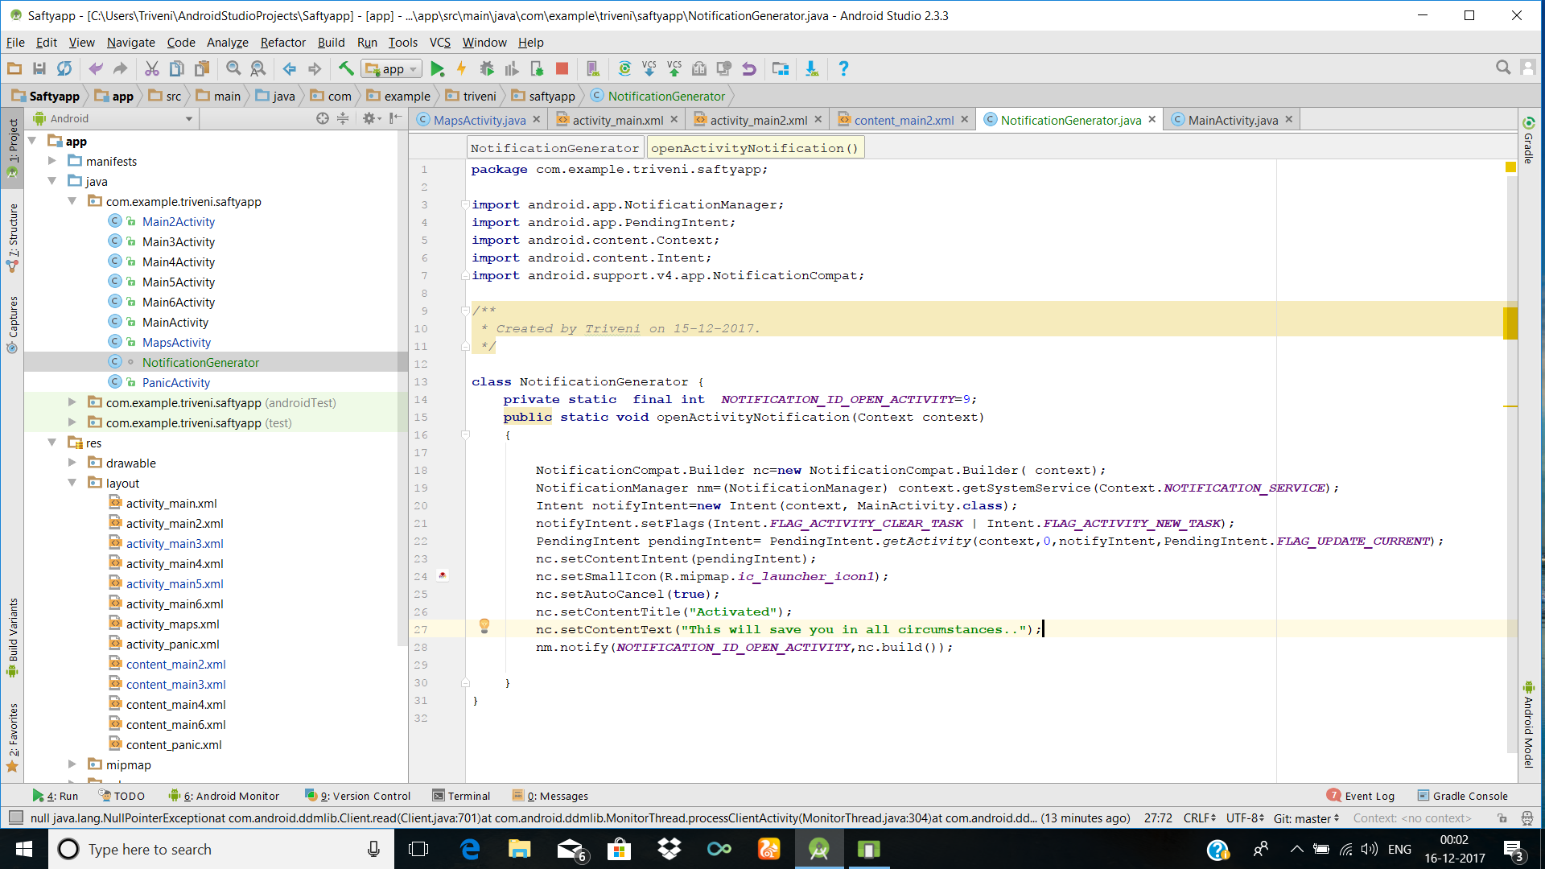
(.java-Notification Bar)

Slide 18
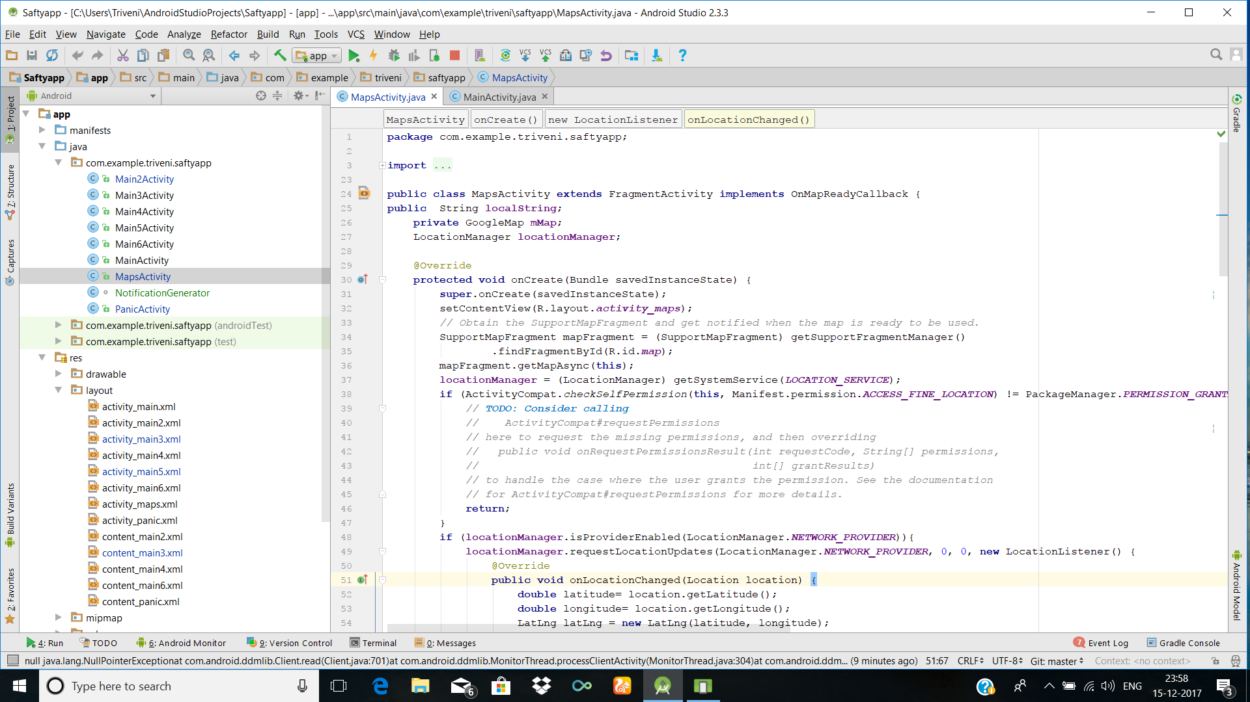
Maps activity

Slide 19
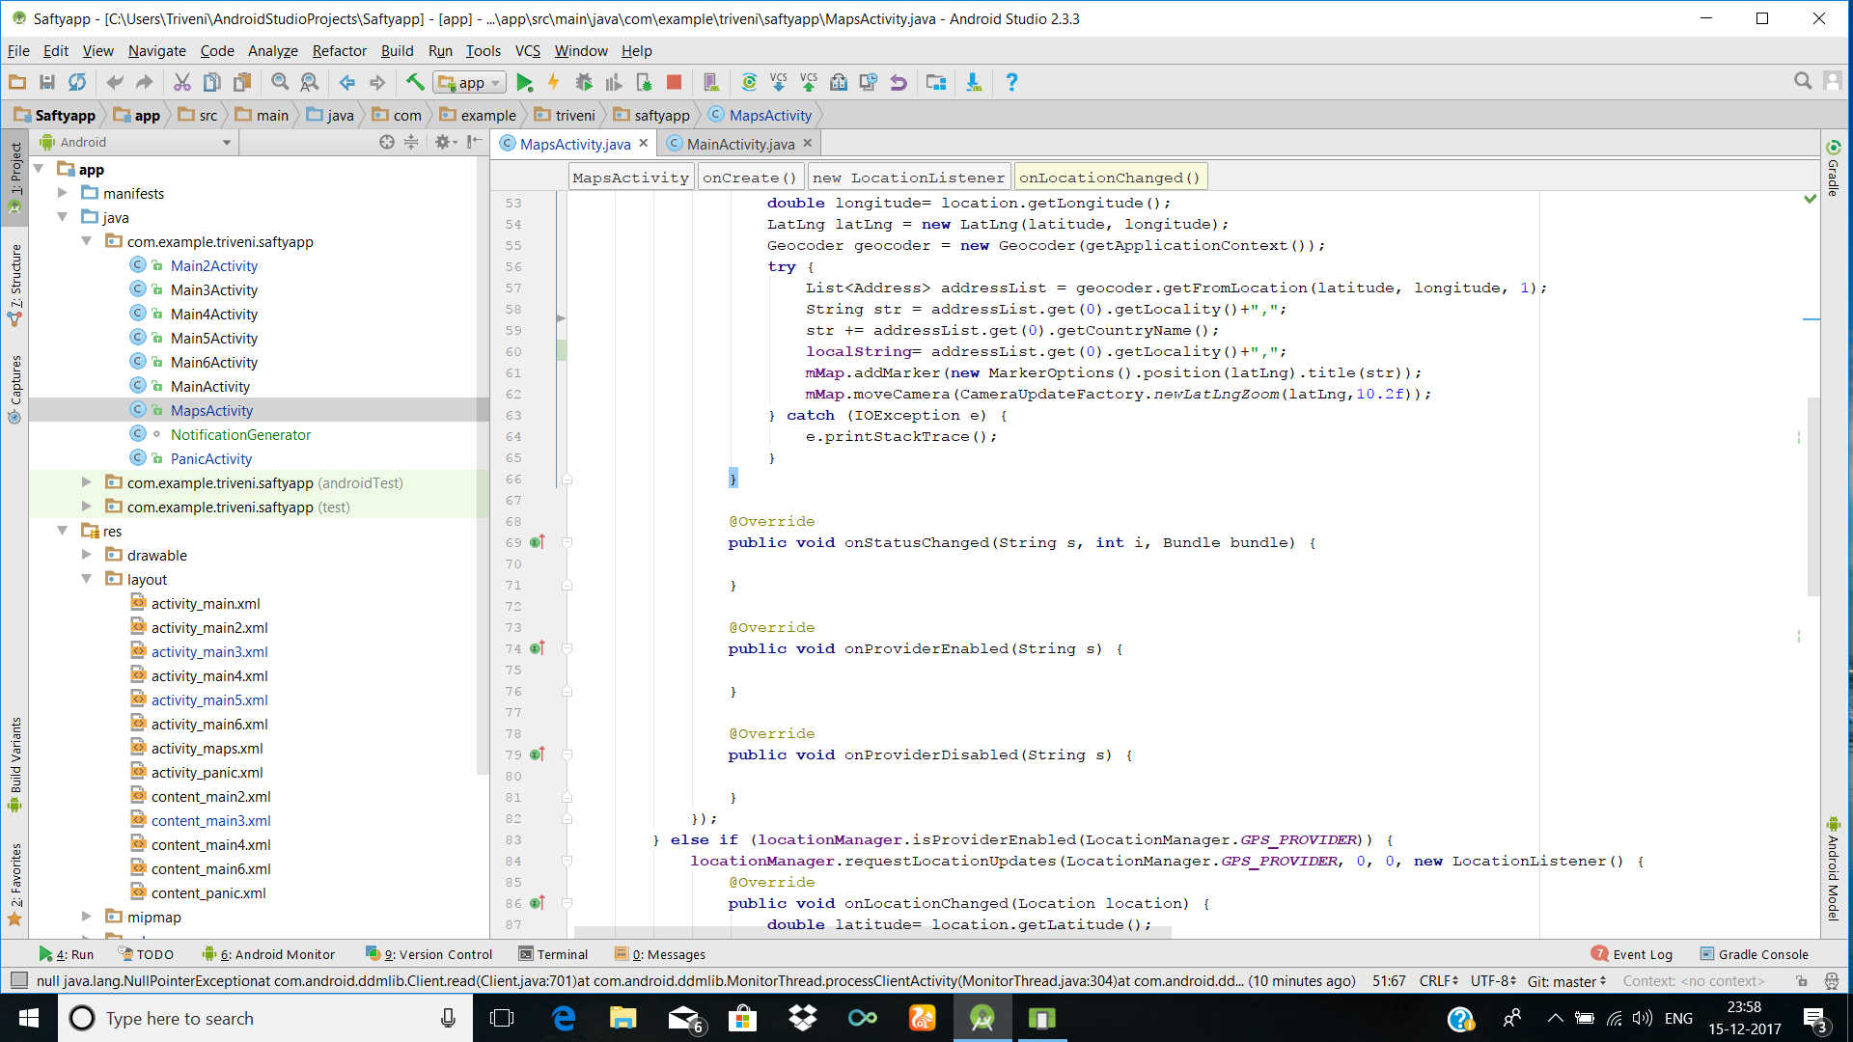

Slide 20
Quick review
After inserting the favourite contacts and setting alert messages and location settings, user will be able to access the application.
So, at last app will be able to send an alert message and the location to the selected contacts.
This is how the application will work & by doing this we can handle the trouble situations in an easy way and provide them safety and security.

Slide 21
Future improvements
Along with the alert message and the location ,A voice message will also be forwarded to the selected contacts.
To be able to record the opponents voice and capture his images and this should also be forwarded to the selected contacts.

Slide 22


